Slide 1





Object Oriented Programming (OOP)

Slide 2

Hello!
I am Eslam Ahmed
I am a software engineer.
You can find me at jeksogsa@gmail.com

Slide 3

Hello!
I am Eman Ehab
I am a ML research engineer.
You can find me at emanehab.ieee@gmail.com

Slide 4



Why OOP ?!
Let’s see Why ^_^

Slide 5
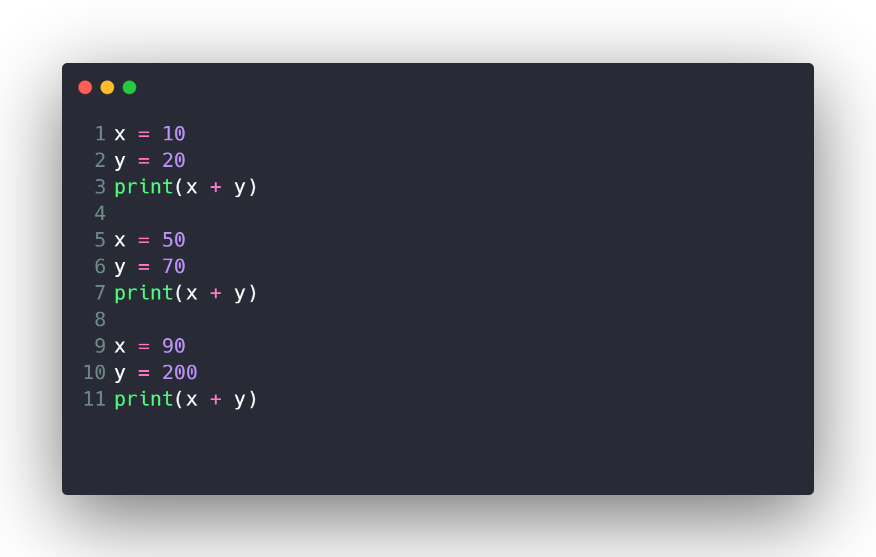
Calculate Sum 10000 times ?!

Slide 6

Calculate Sum 10000 times ?!
What if I want to modify code to multiply ?

Slide 7
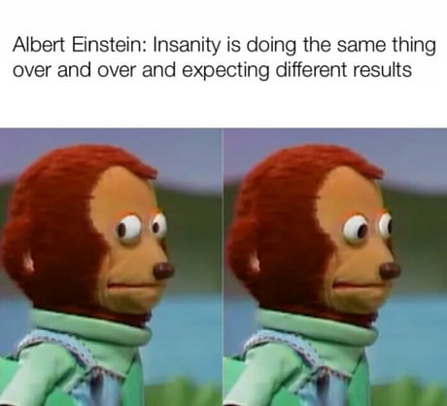
Calculate Sum 10000 times ?!
What if I want to modify code to multiply ?

Slide 8
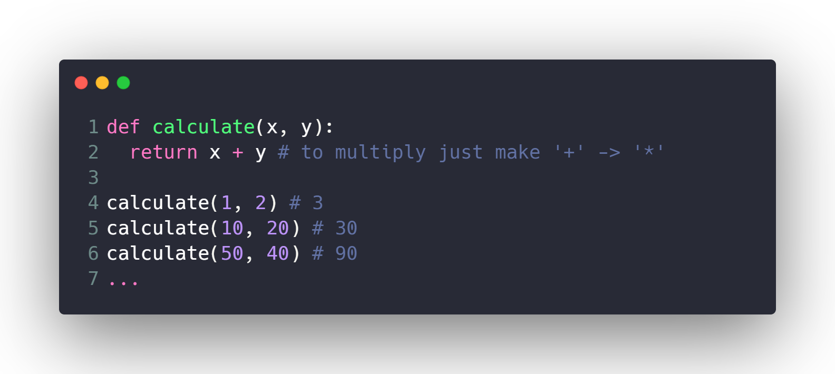
Calculate Sum 10000 times ?!
What if I want to modify code to multiply ?

Slide 9
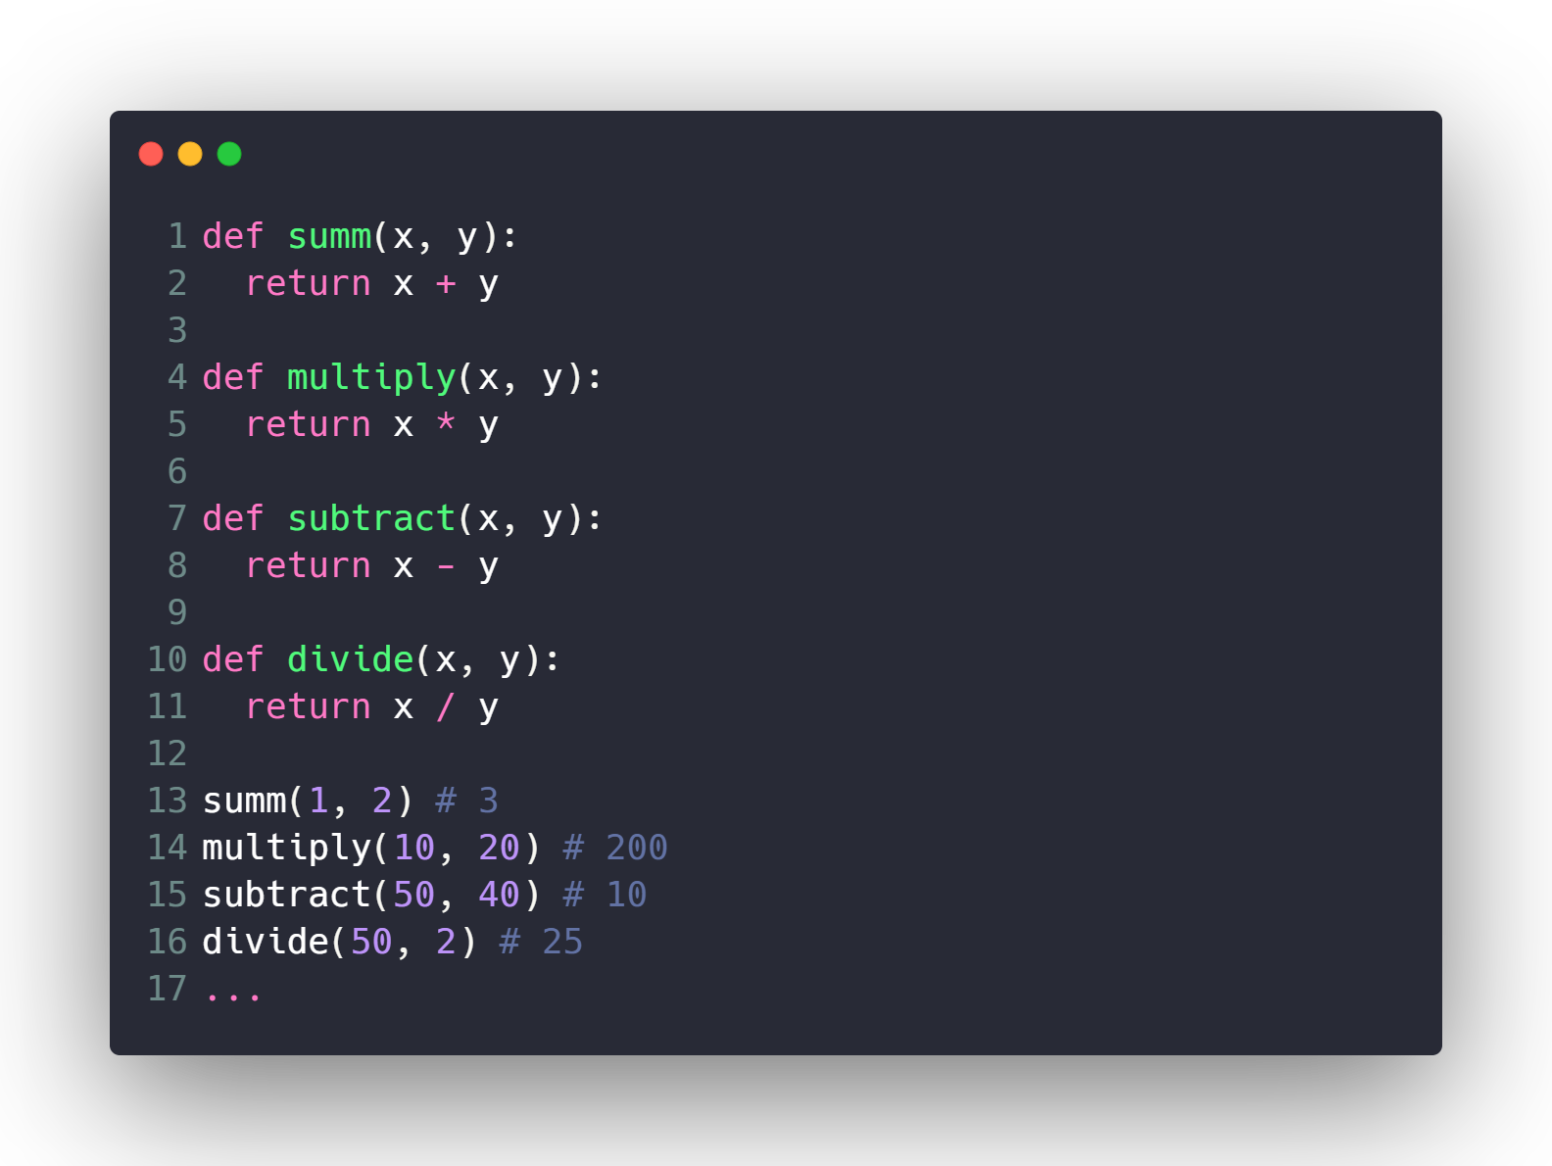
Make Full Calculator ?

Slide 10
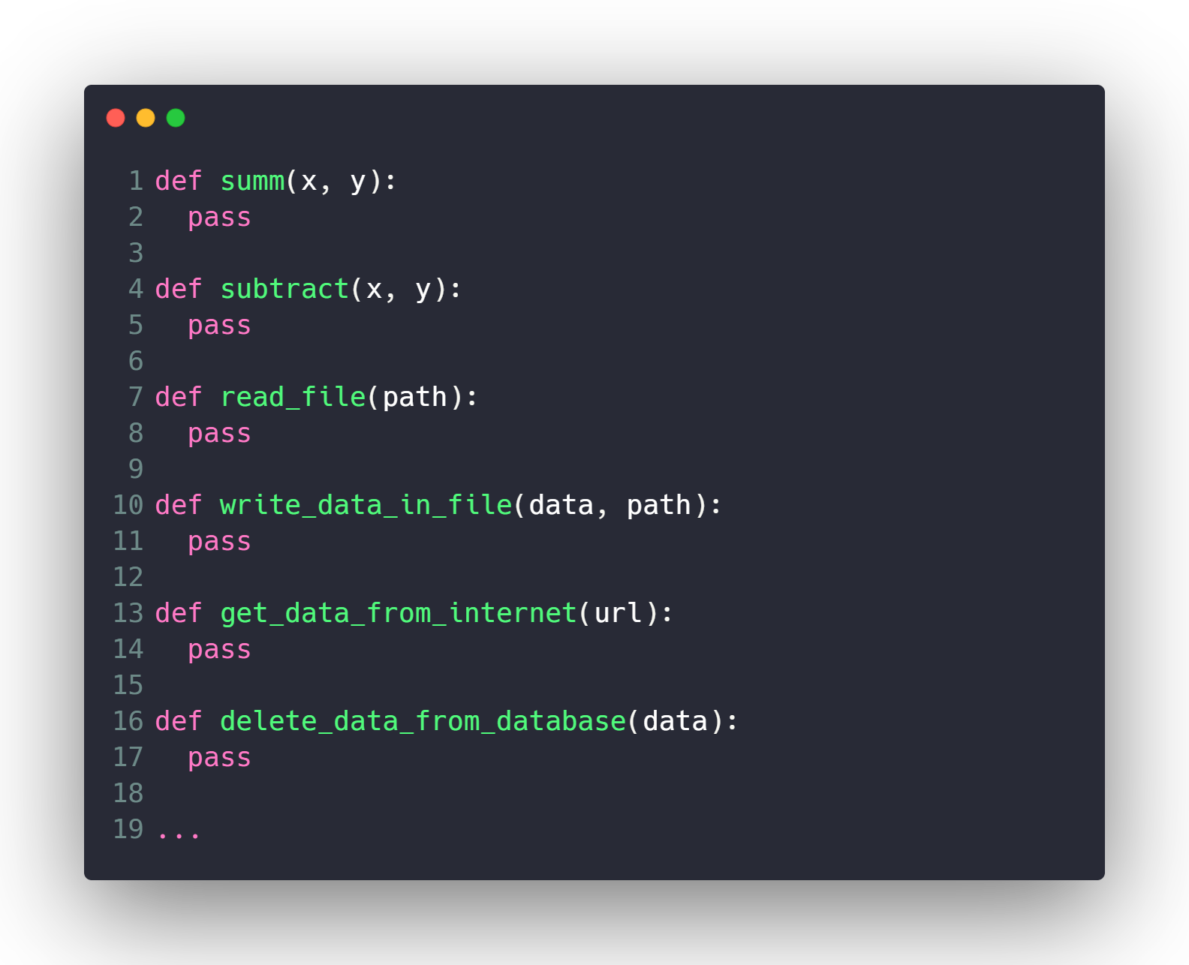
Make Lots of Features ?

Slide 11
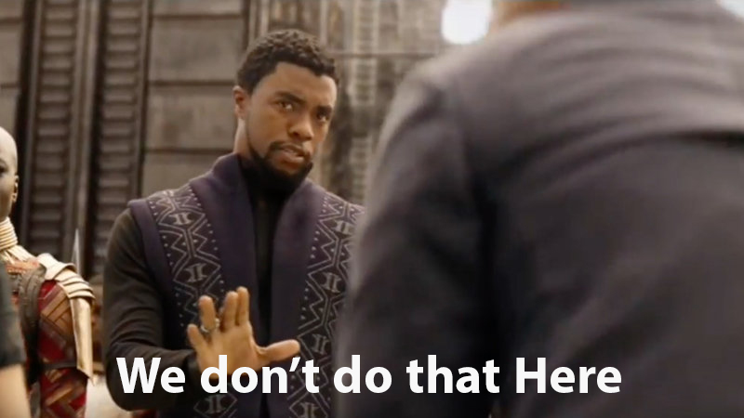
Make Lots of Features ?

Slide 12








What is OOP ?!
Everything is an
Object

Slide 13
Dog
Attributes
Size
Color
Breed
Age
…
Methods
Run()
Park()
Eat()
Sleep()
…

Slide 14
Car
Attributes
Model
Color
Plate Number
Speed
…
Methods
Steer()
Back()
Break()
Throttle()
…

Slide 15
Person
Attributes
Name
Age
Address
Gender
…
Methods
Eat()
Sleep()
Walk()
Pray()
…

Slide 16
Camera
Attributes
Lens_width
Has_Flash
Depth
…
Methods
Take_Photo()
Take_Video()
Toggle_Flash()
Zoom()
…

Slide 17
Classes & Objects

Slide 18
Person
Attributes
Name
Age
Address
Gender
…
Methods
Eat()
Sleep()
Walk()
Pray()
…

Slide 19
Class: Person
Object 1
Name: Eslam
Age: 26
Gender: Male
Eat Meat
Sleep at 9 pm
Object 2
Name: Ahmed
Age: 15
Gender: Male
Eat Chicken
Sleep at 12 am
Object 3
Name: Sara
Age: 30
Gender: Female
Eat Fish
Sleep at 6 am

Slide 20
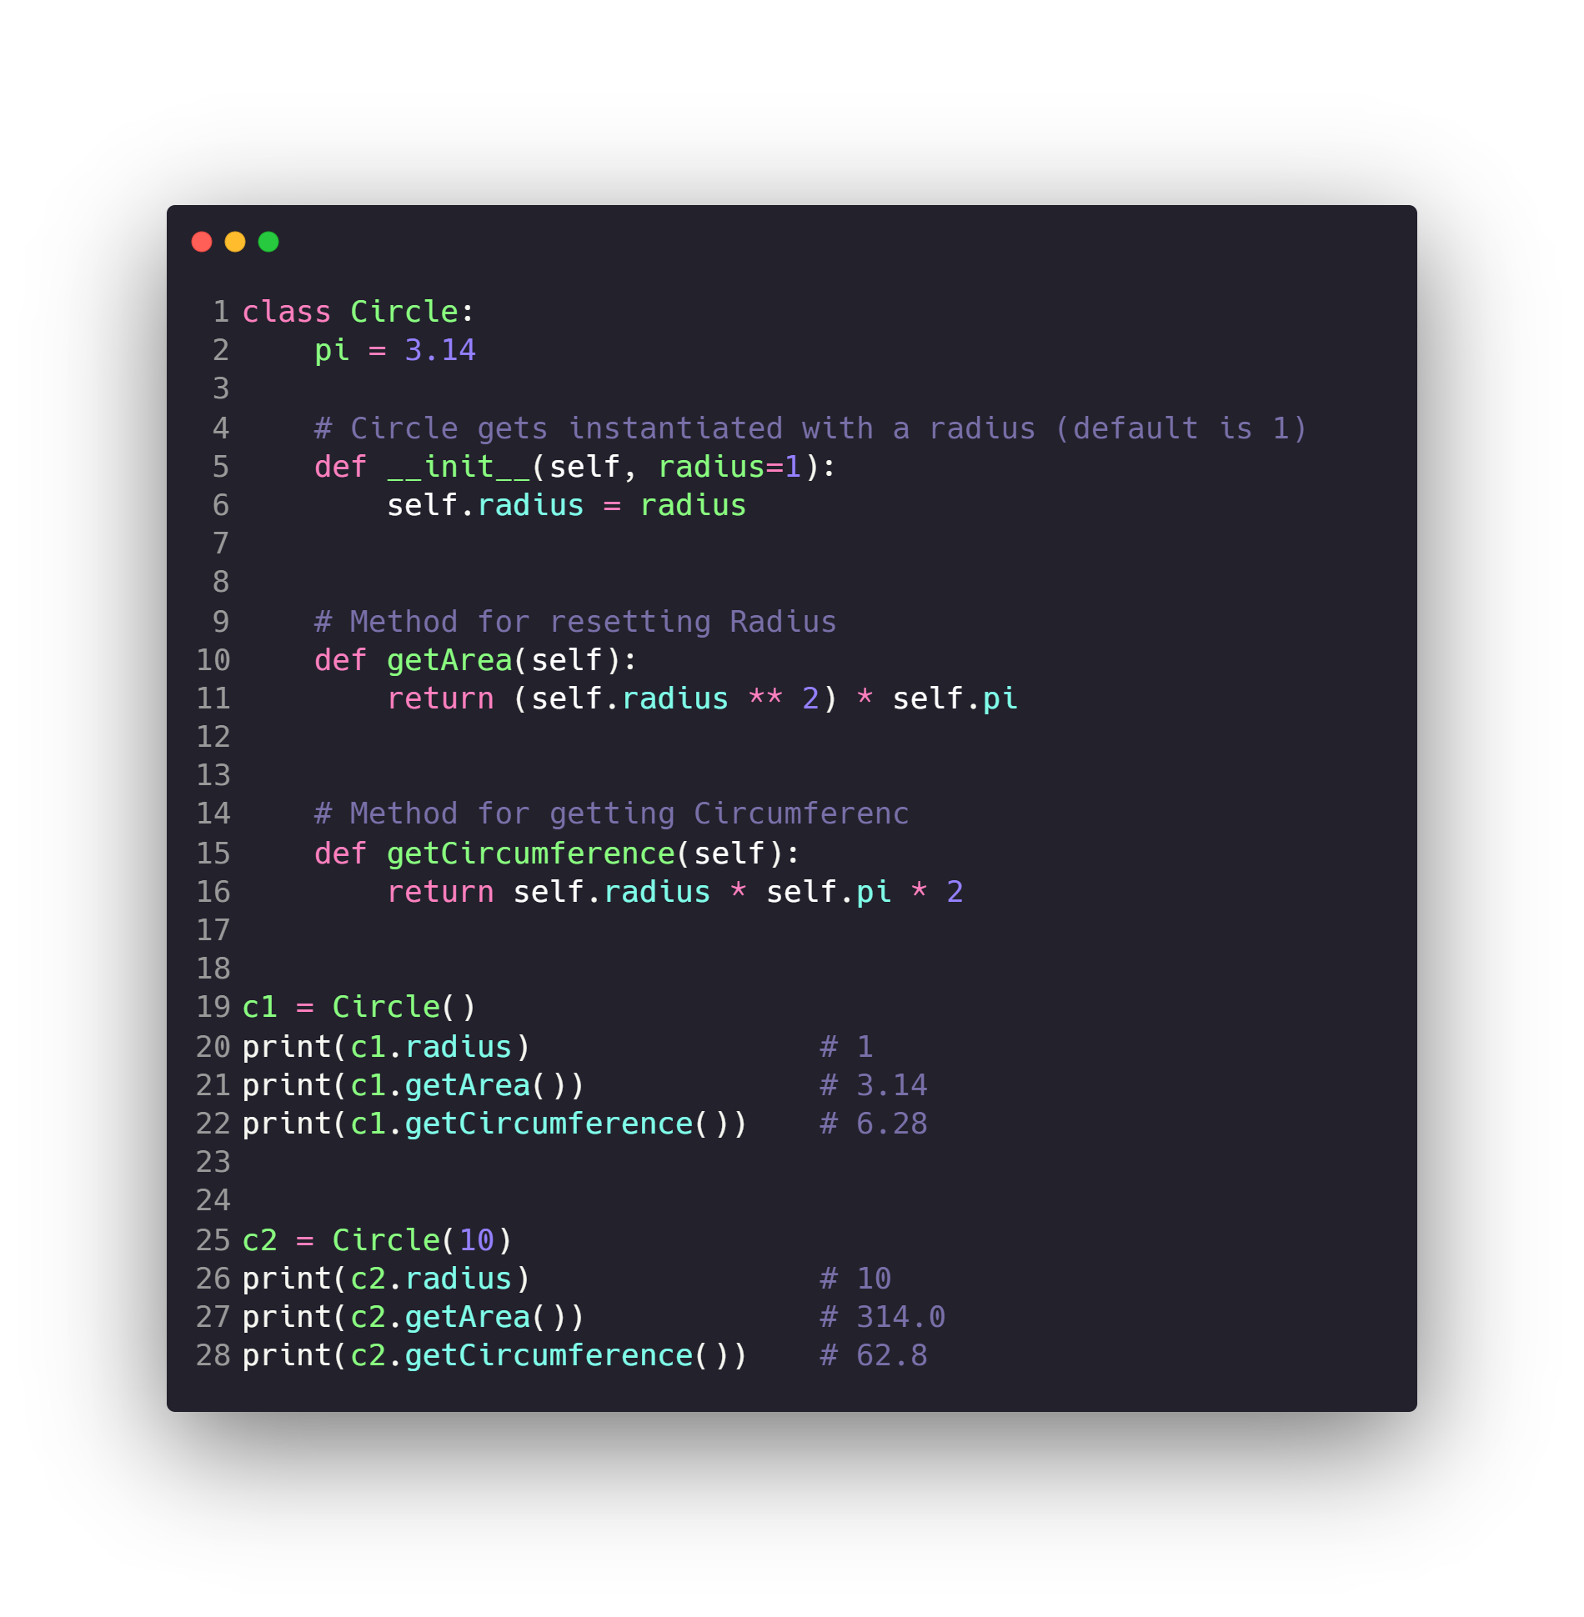
OOP in Python ?
Circle

Slide 21
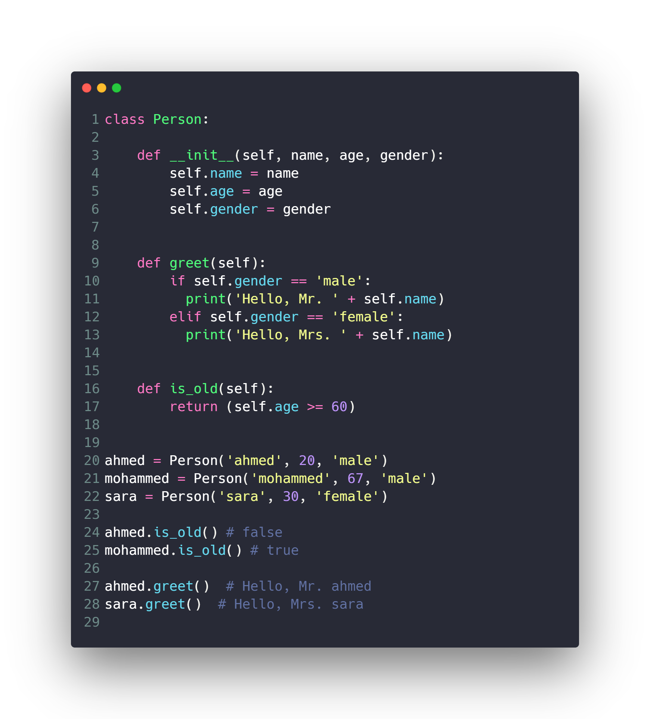
OOP in Python ?
Person

Slide 22
OOP Concepts
Data Hiding (Encapsulation)
Inheritance
Polymorphism
Special Functions and Operators Overloading
Static Attributes & Methods

Slide 23
Data Hiding (Encapsulation)

Slide 24
Data Hiding (Encapsulation)
An object's attributes may or may not be visible outside the class definition. You need to name attributes with a double underscore prefix, and those attributes then are not be directly visible to outsiders.

Slide 25
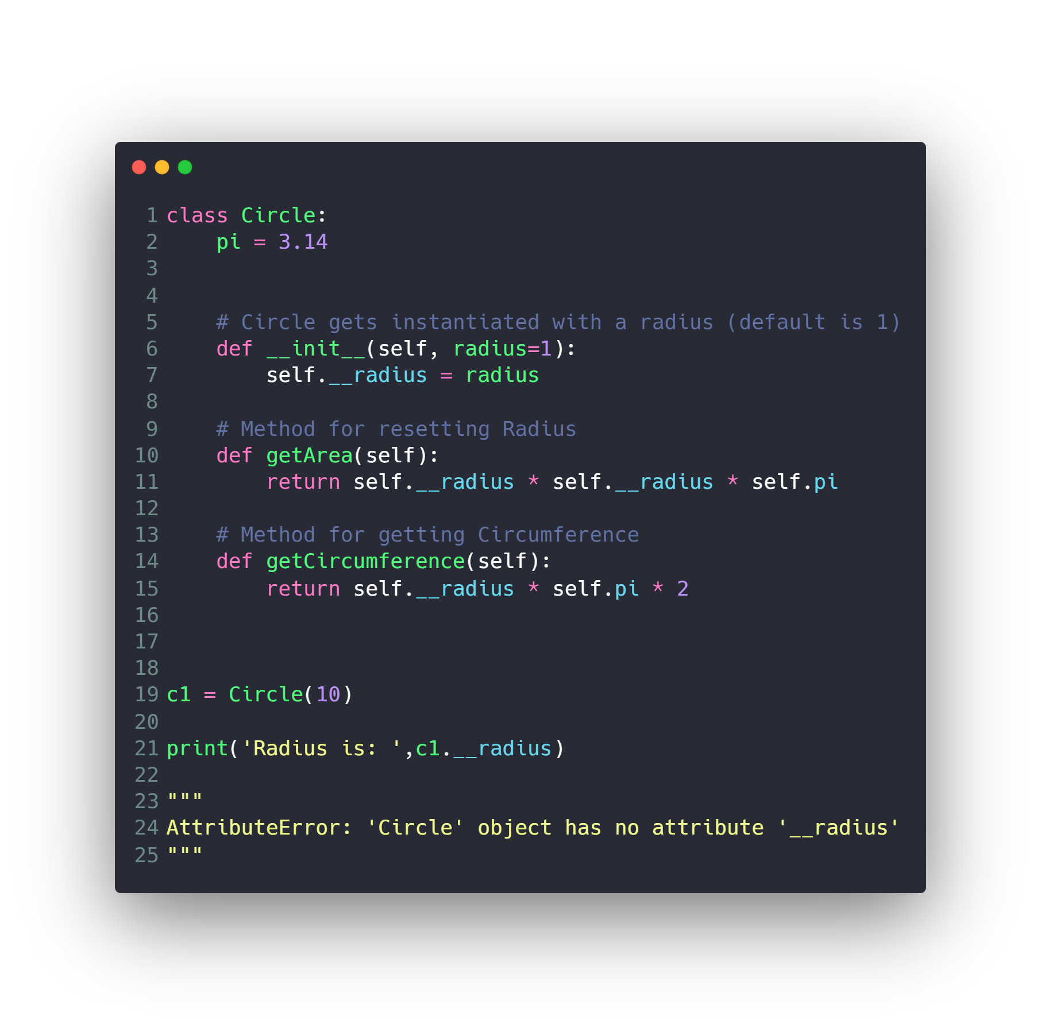
Data Hiding (Encapsulation)
Private members

Slide 26
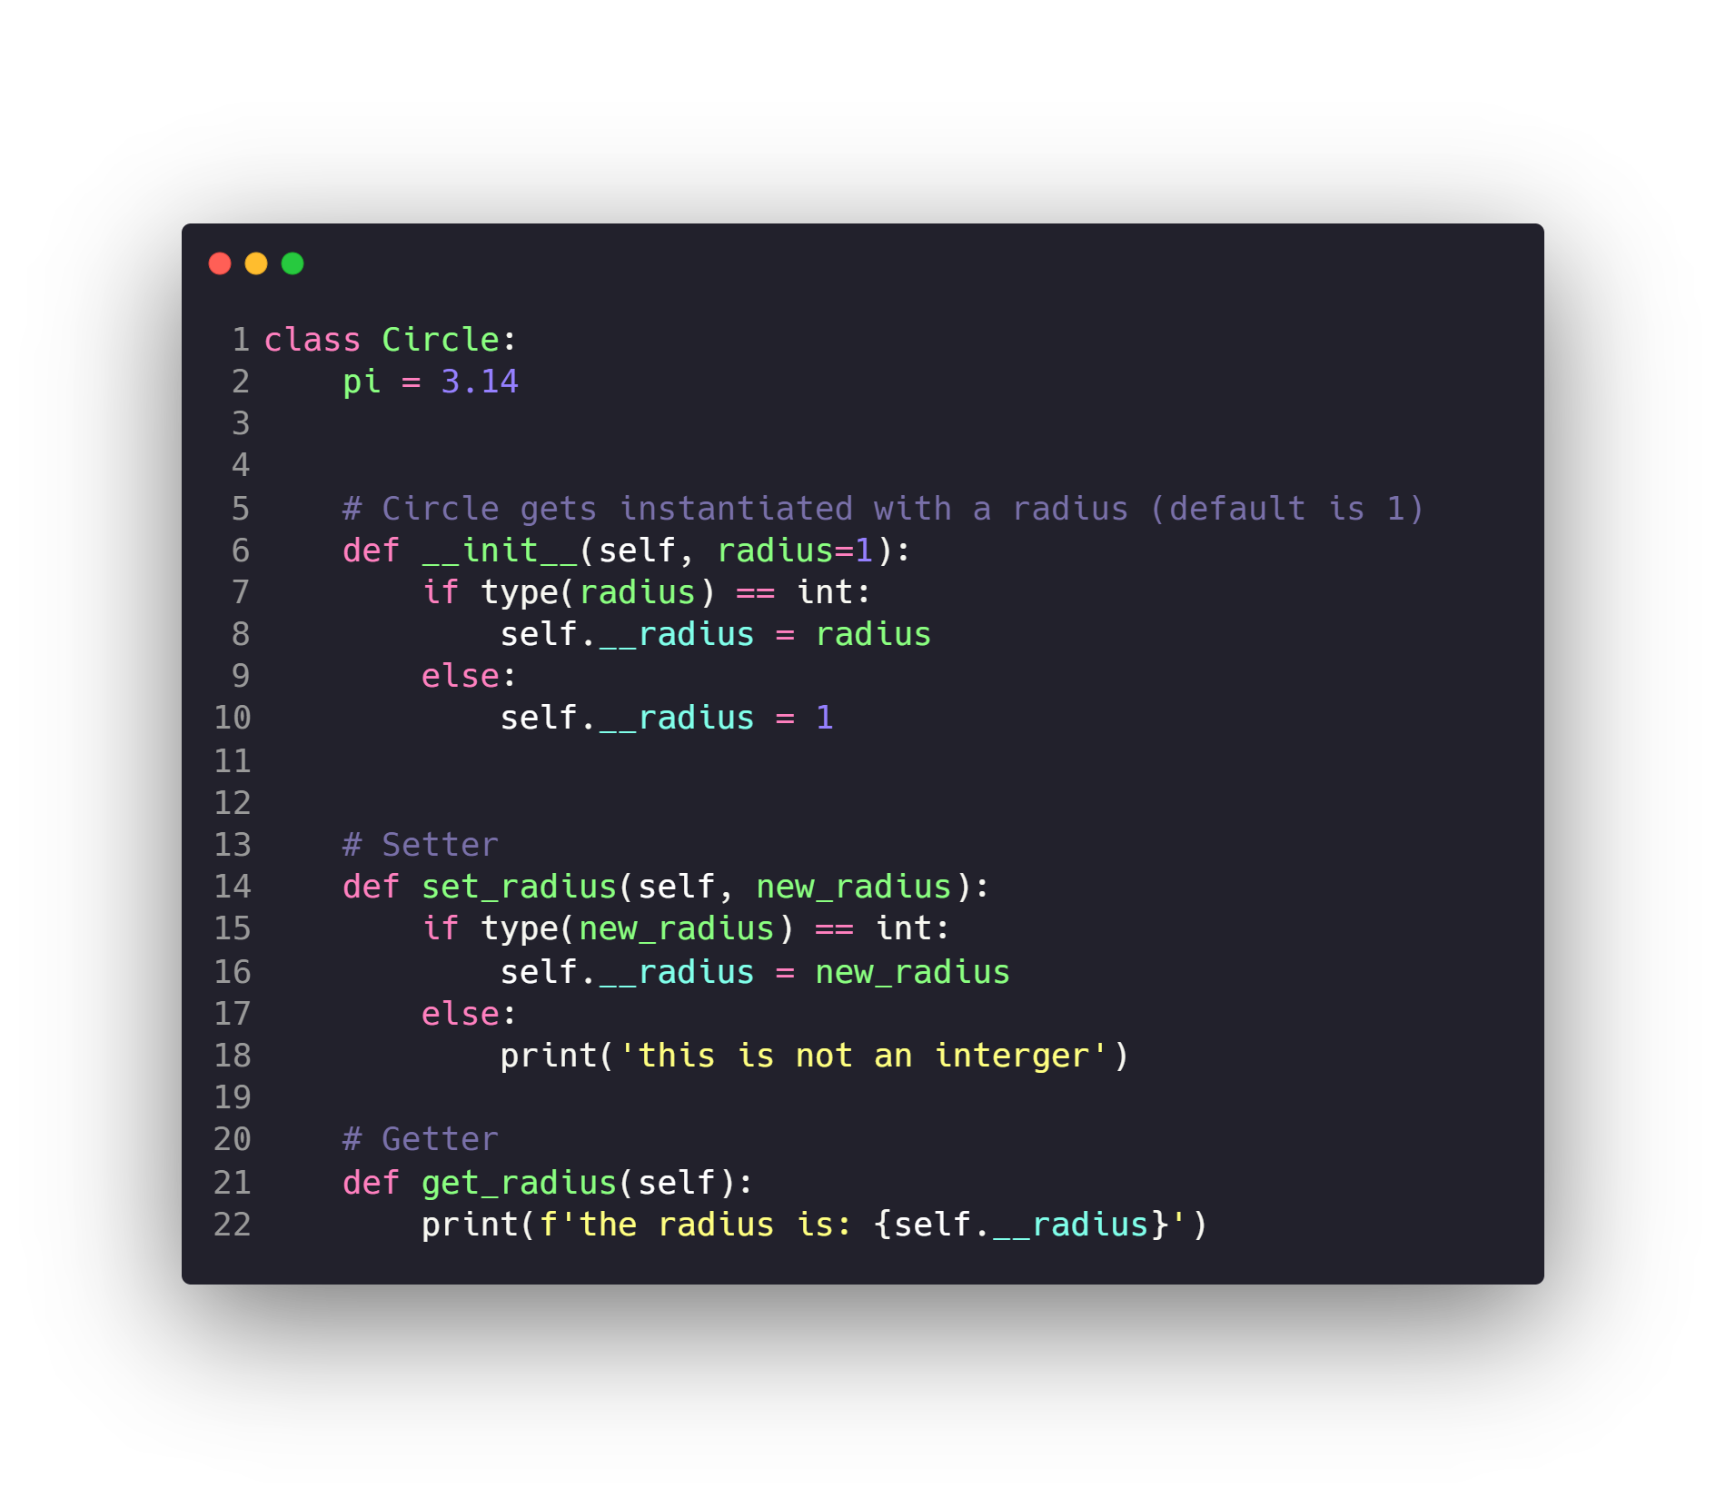
Data Hiding (Encapsulation)
Setter and Getter

Slide 27
OOP Concepts
Data Hiding (Encapsulation)
Inheritance
Polymorphism
Special Functions and Operators Overloading
Static Attributes & Methods

Slide 28
Inheritance

Slide 29
Inheritance
It is a way to form new classes using classes that have already been defined. The newly formed classes are called derived classes, the classes that we derive from are called base classes.

Slide 30
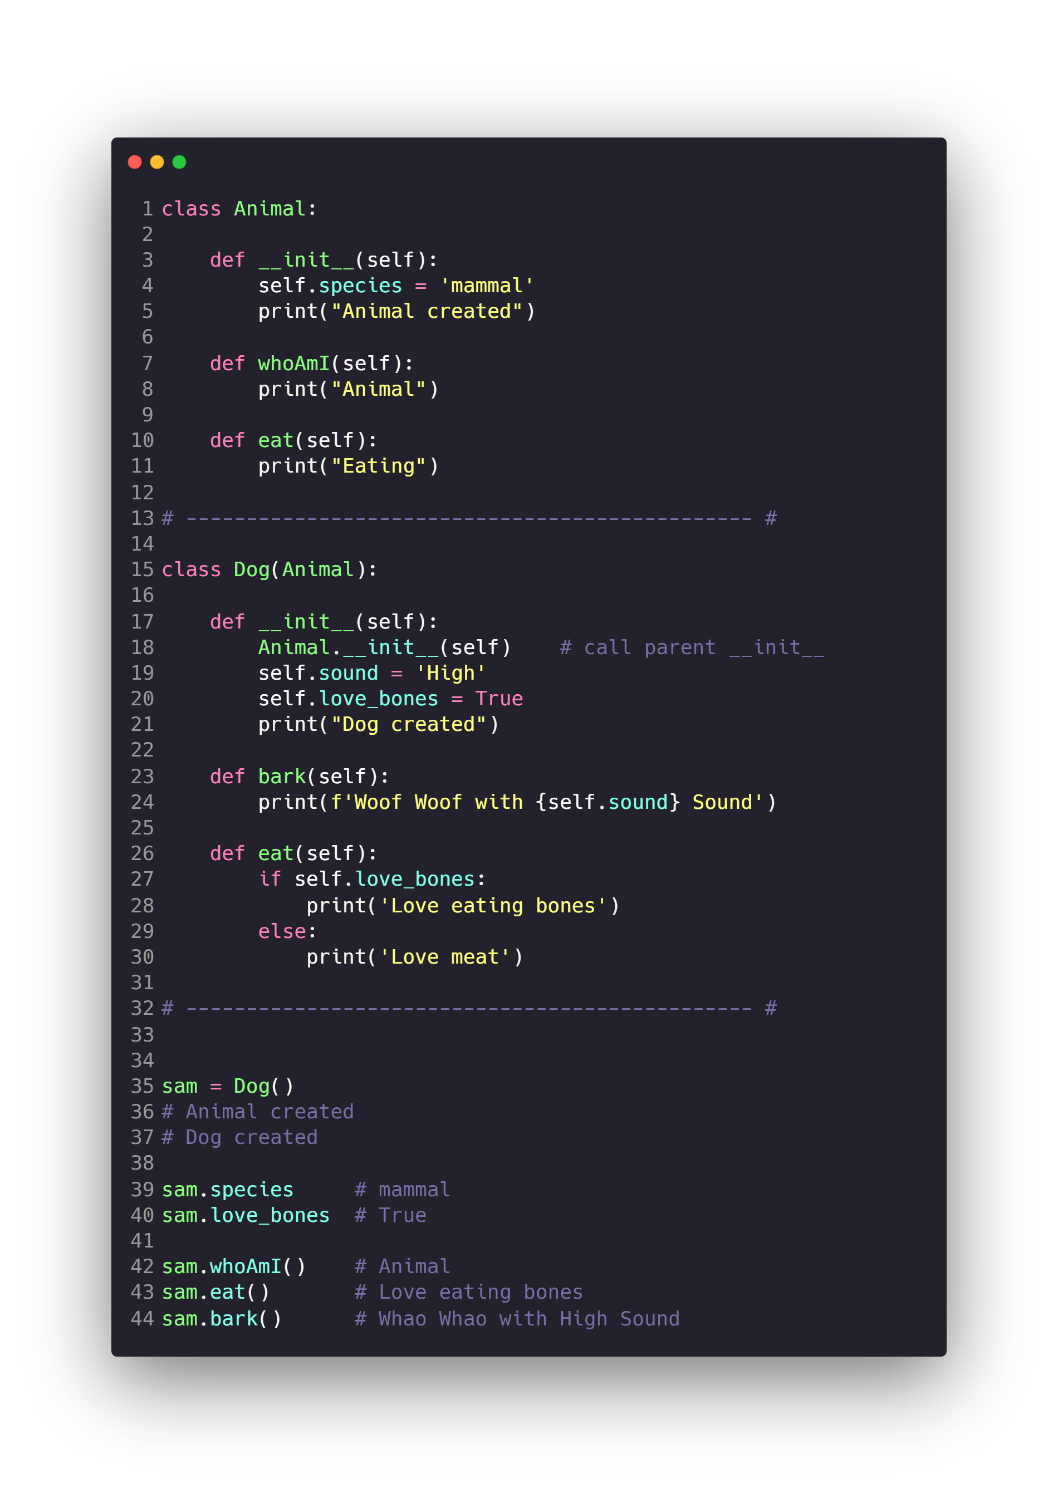
Inheritance

Slide 31
OOP Concepts
Data Hiding (Encapsulation)
Inheritance
Polymorphism
Special Functions and Operators Overloading
Static Attributes & Methods

Slide 32
Polymorphism

Slide 33
Polymorphism
polymorphism refers to the way in which different object classes can share the same method name but each acts differently.

Slide 34
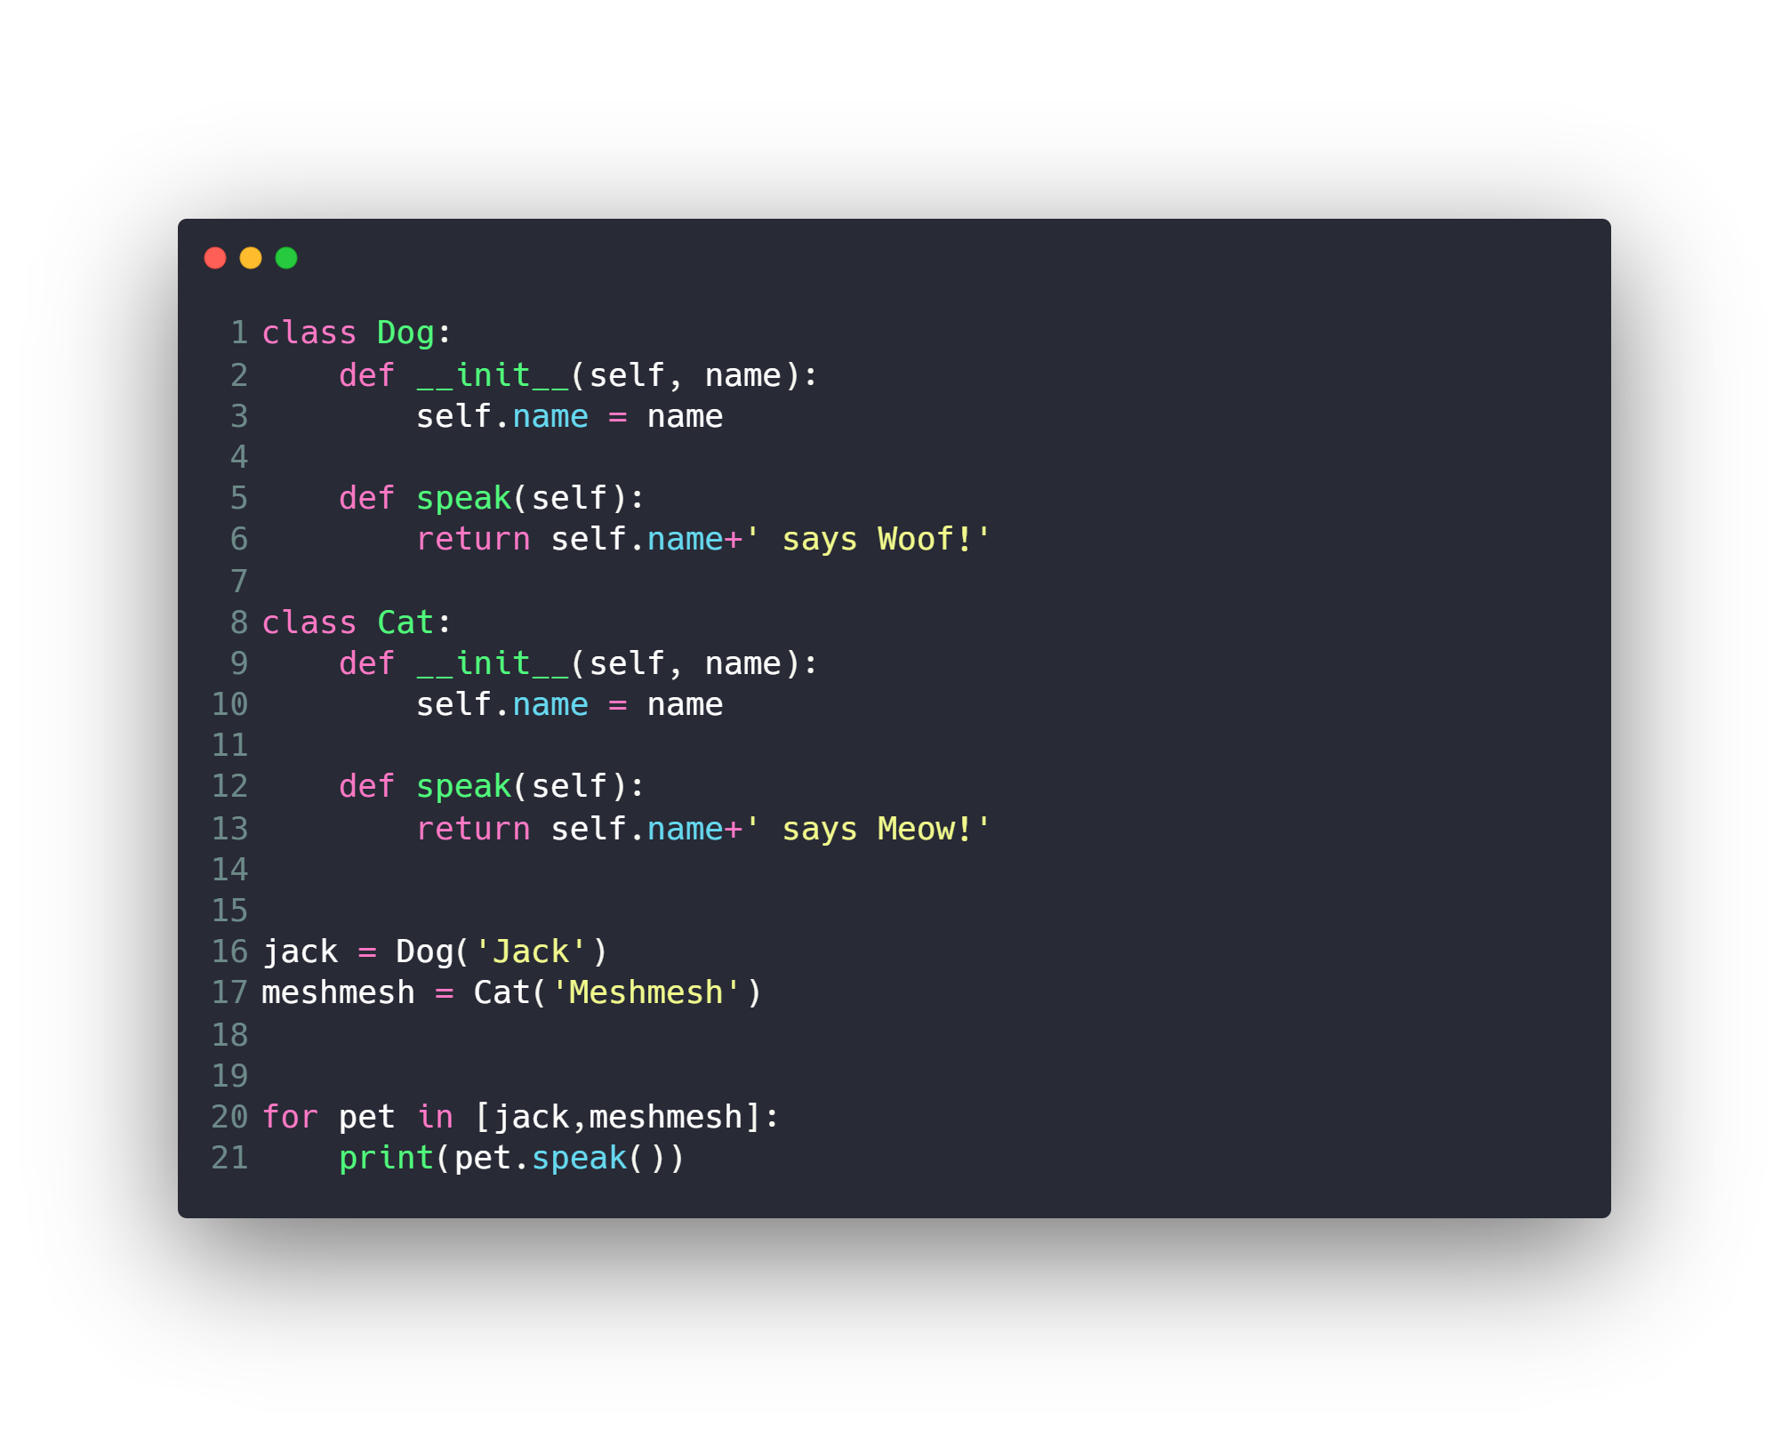
Polymorphism

Slide 35
OOP Concepts
Data Hiding (Encapsulation)
Inheritance
Polymorphism
Special Functions and Operators Overloading
Static Attributes & Methods

Slide 36
Special Functions and Operators Overloading
Math Operators
Comparison Operators
Other Operators
__add__
__sub__
__mul__
__truediv__
__floordiv__
__mod__
__pow__
__eq__
__nq__
__lt__
__le__
__gt__
__ge__
__init__
__str__
…

Slide 37
OOP Concepts
Data Hiding (Encapsulation)
Inheritance
Polymorphism
Special Functions and Operators Overloading
Static Attributes & Methods

Slide 38
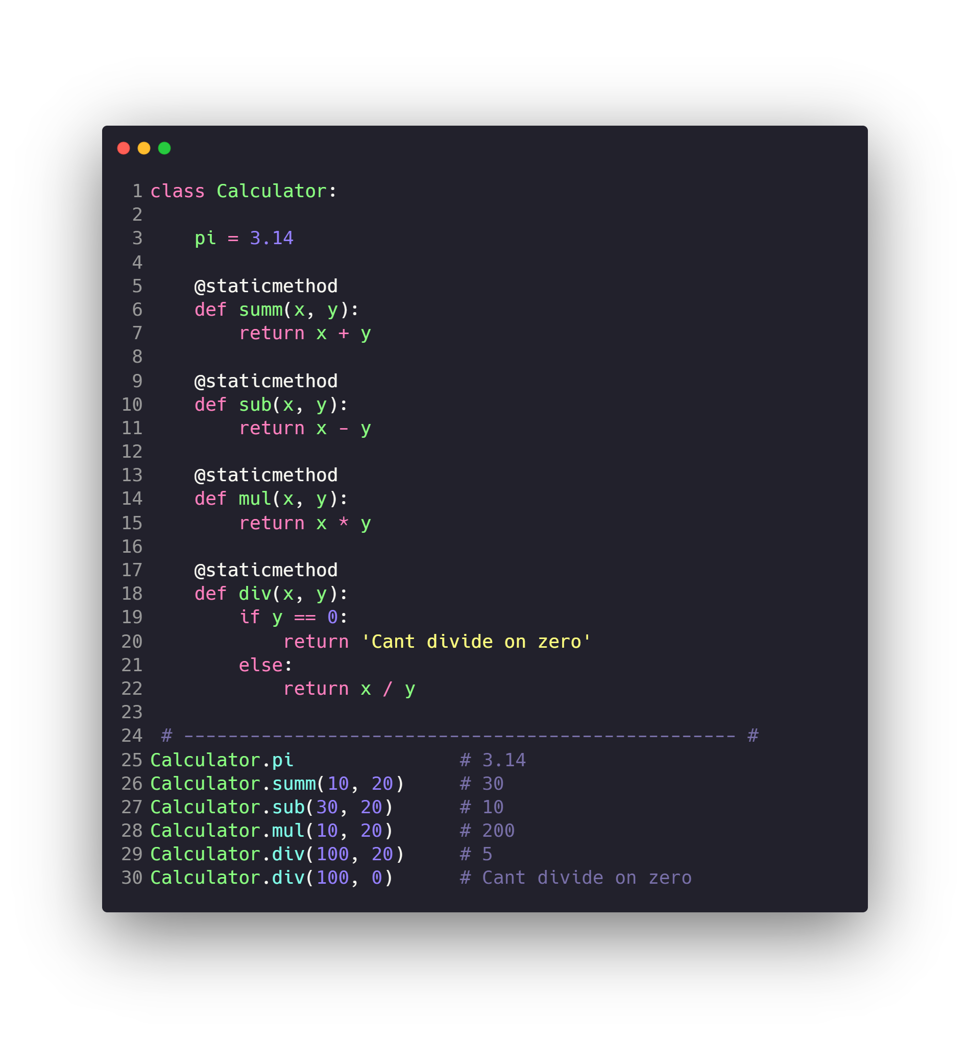
Static Attributes & Methods

Slide 39
Other Concepts
Exceptions
Decorators
Iterators and Generators

Slide 40
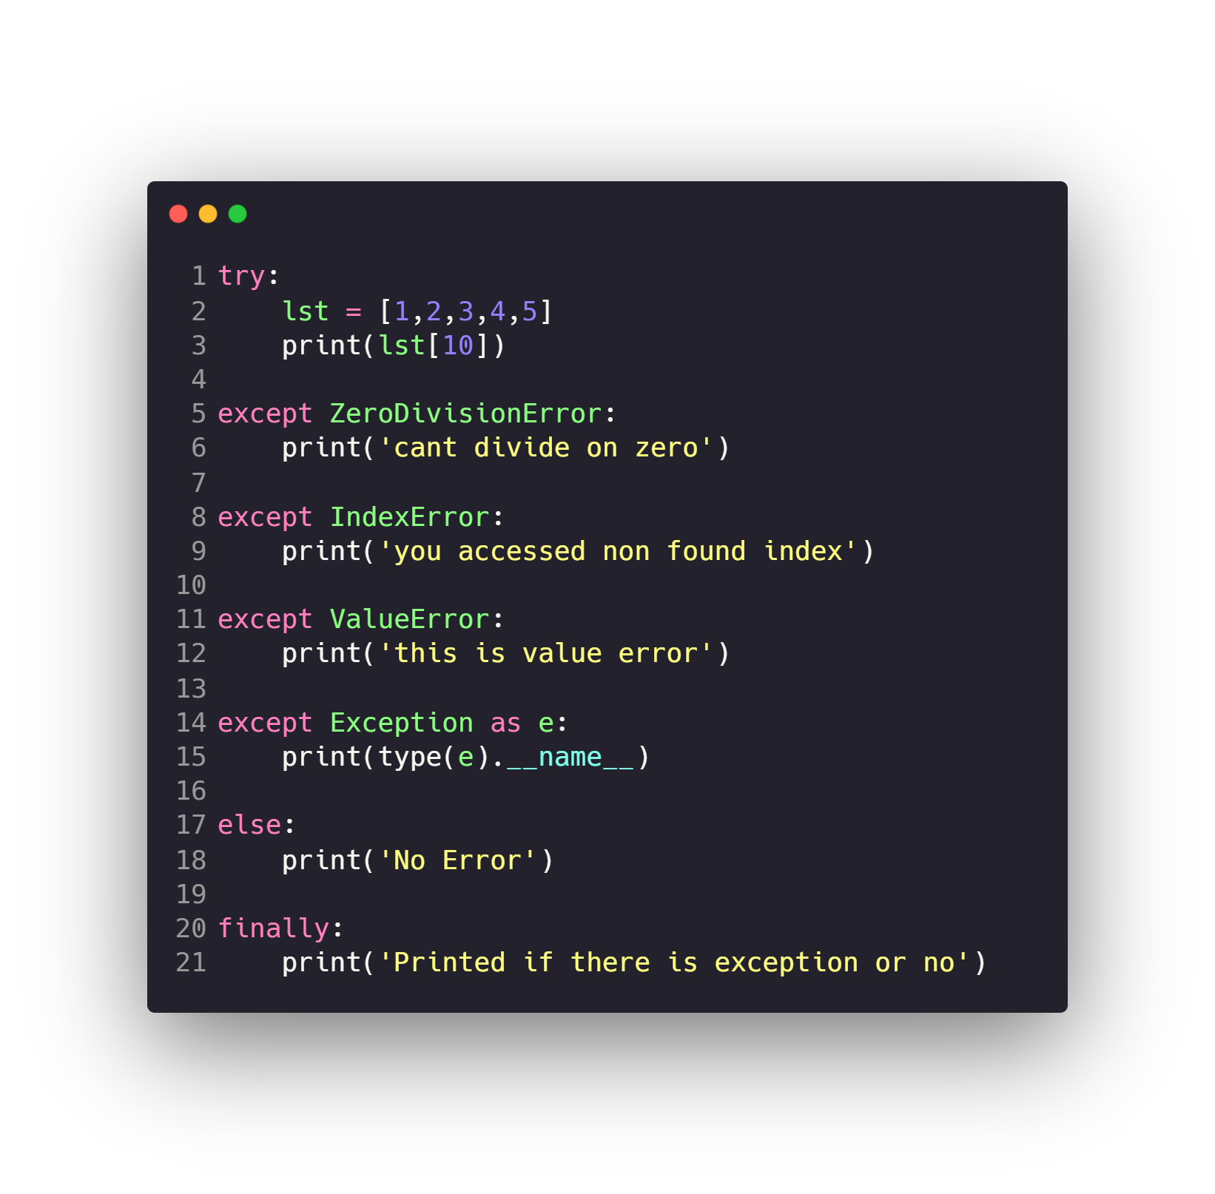
Exceptions
Check Python Error Types
https://docs.python.org/3/library/exceptions.html

Slide 41
Other Concepts
Exceptions
Decorators
Iterators and Generators

Slide 42
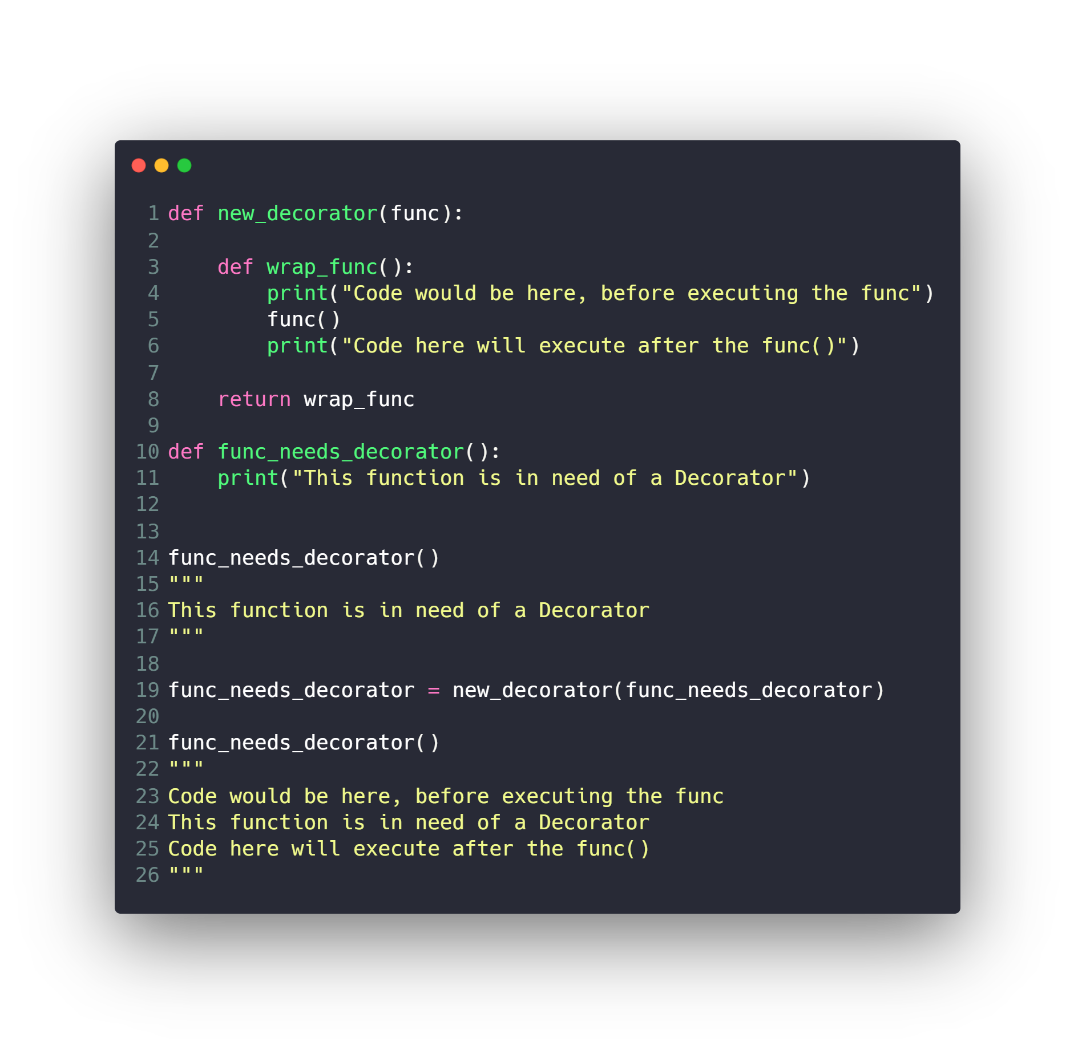
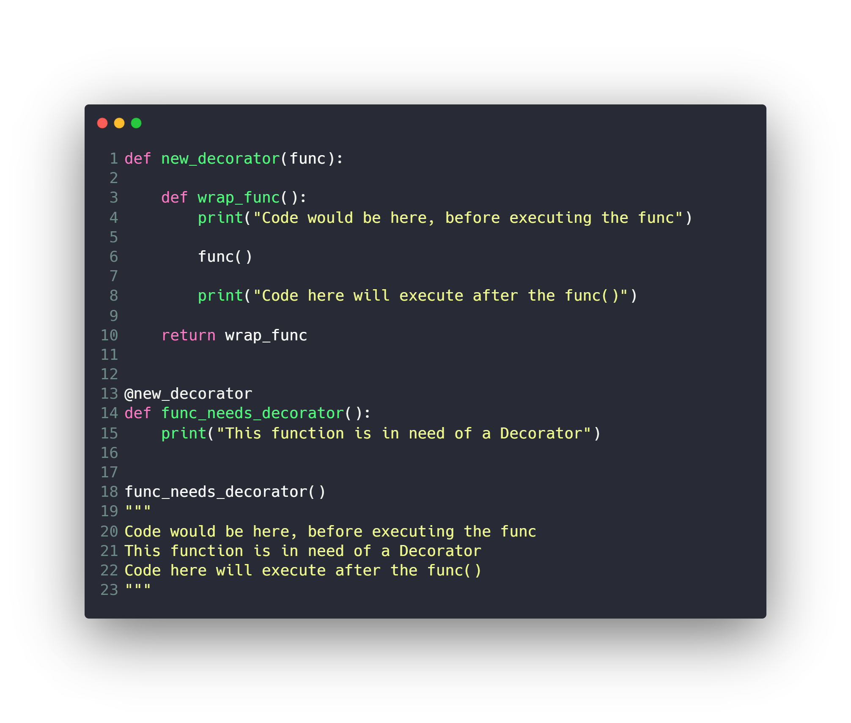
Decorators

Slide 43
Other Concepts
Exceptions
Decorators
Iterators and Generators

Slide 44
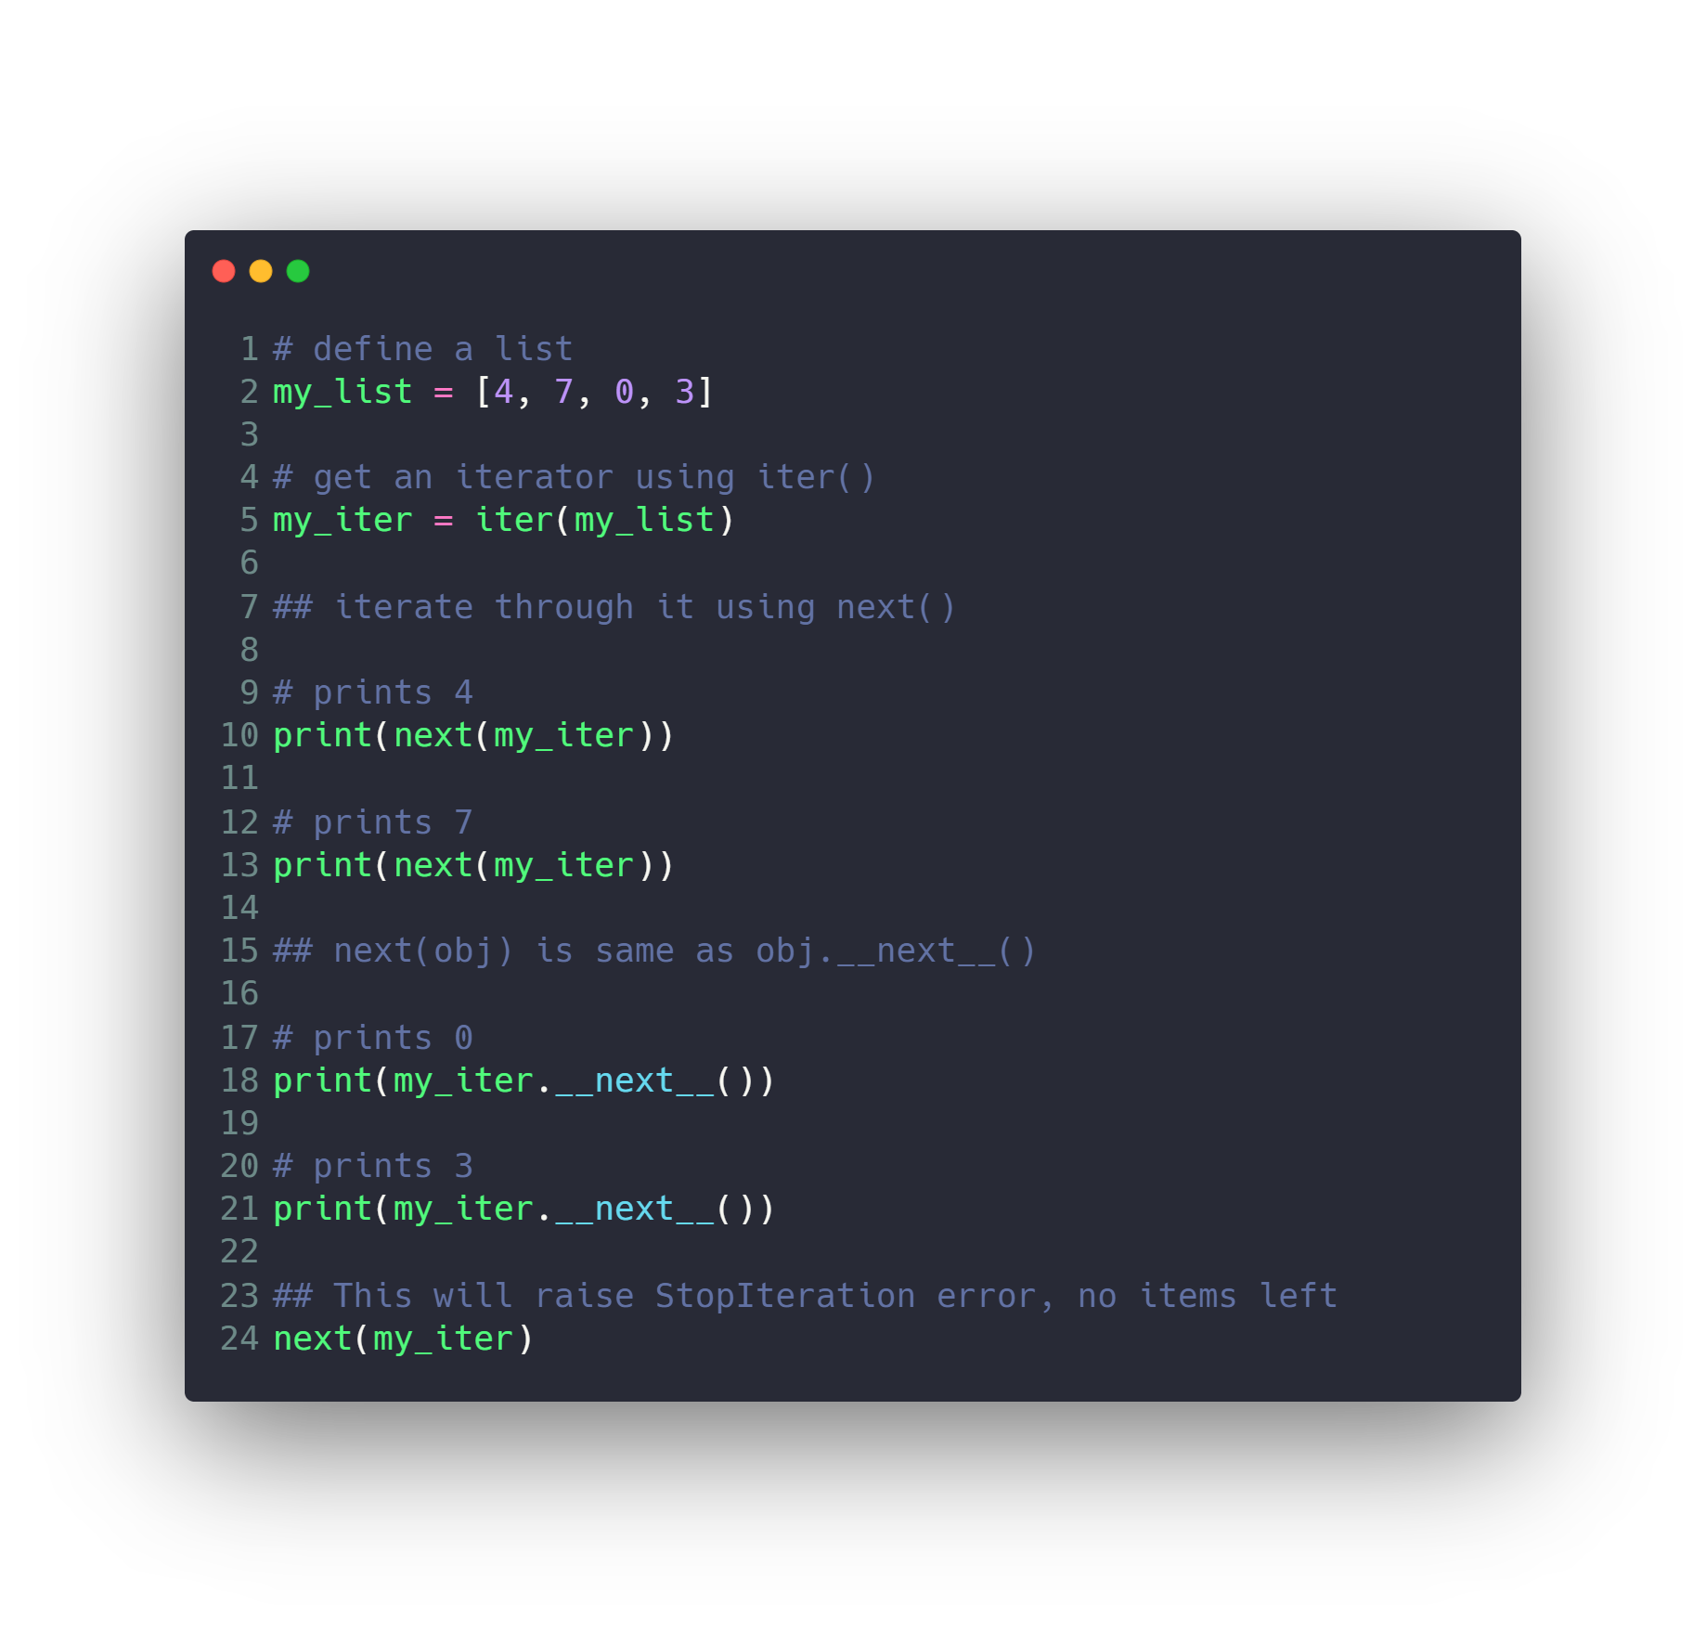
Iterators

Slide 45
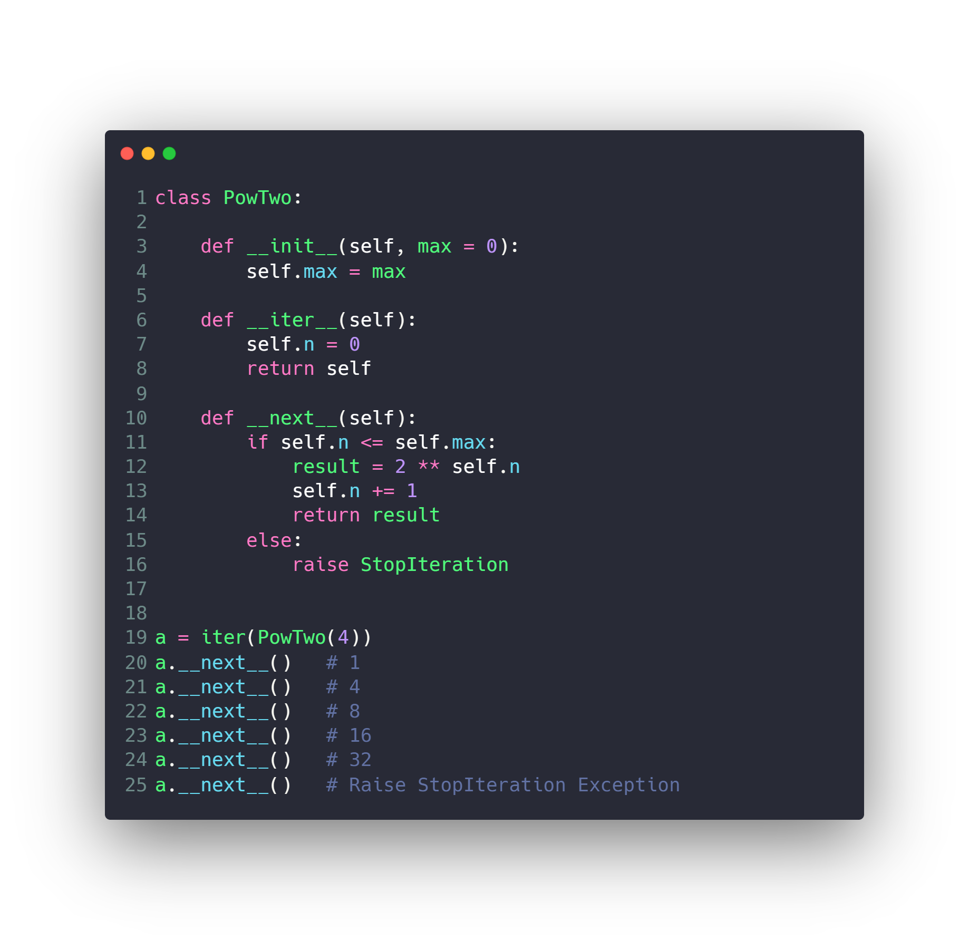
Custom Iterators

Slide 46
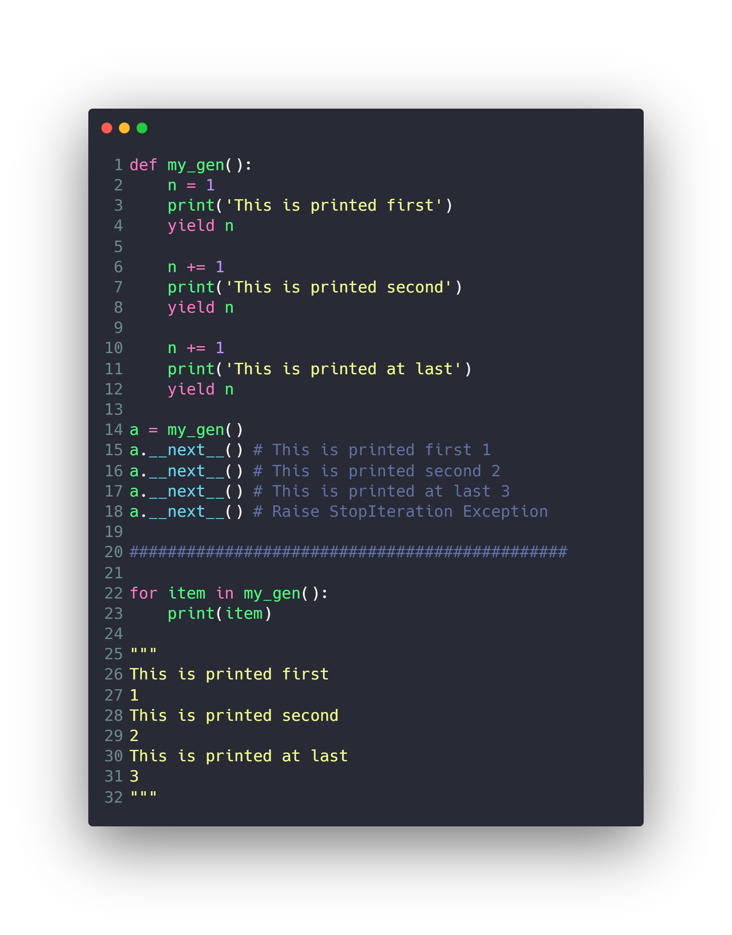
Generator
Much Better
no need to implement __iter()__ and __next__()

Slide 47
Questions ?!

Slide 48

Thanks! >_ Live long and prosper

